Slide 1
Prime Factorization Prime and Composite Numbers

Slide 2
Prime Number
A prime number is any whole number that has only two factors, itself and 1.
Example:
5
It only has two factors, 5 and 1
5 x 1= 5
What are other examples of prime numbers?

Slide 3
Composite Number
Any number that is not a composite number
Example:
24
2 x 12 = 24
4 x 6 = 24
3 x 8 = 24
24 x 1 = 24

Slide 4
Practice Problems
Are the following numbers prime or composite?
7
16
36
13

Slide 5
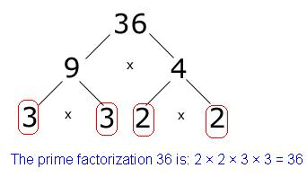
Prime Factorization
Prime factorization is finding the prime factors of a number.
A factor tree can be used to find the prime factors.

